Slide 1
Capstone Project - The Battle of Neighborhoods
Clustering Subway Stations in Bronx based on competitor concentration

Slide 2
The Business Problem
NYC Foods is planning to set up a network of food trucks across New York City. They plan to capitalise on the high population and robust Subway network of the city.
We are entrusted with the project of narrowing down on the most suitable subway stations in The Bronx, where NYC Foods can put up the first set of food trucks.
The best stations will be the ones with low concentration of other food trucks, food stalls or fast food joints near the station as these are our client's direct competitors.

Slide 3
Data Acquisition
The details all subway stations in New York City is obtained from Spatial Data Repository of NYU. The .json file has names and coordinates of all the subway stations of New York.
Our client has decided to begin operations in the borough of The Bronx. The names of stations in The Bronx will be obtained from Metropolitan Transportation Authority.
The details of our competitors (fast food joints, food trucks and food stalls) near each subway station will be obtained using Foursquare API.

Slide 4
Data Cleaning
The json file needs to be put in a Data Frame.
The names of stations in Bronx needs to be cleaned to match the same in the Data Frame.

Slide 5
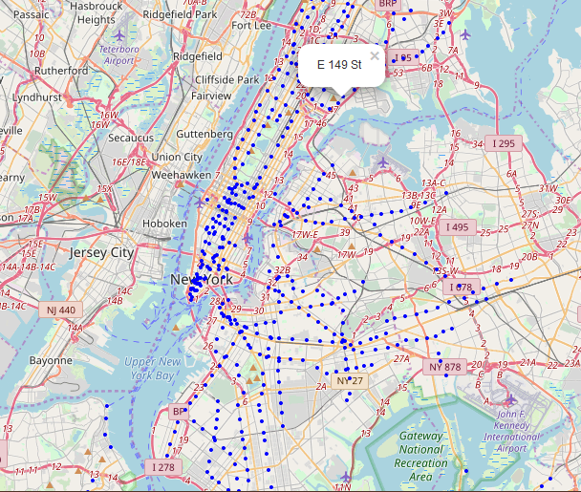
New York Subway Stations

Slide 6
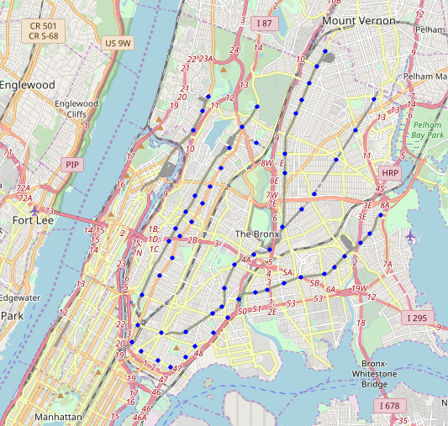
The Bronx Subway Stations

Slide 7
Competitor Details
We use Foursquare API to get details of competitors around each subway station.
Only those venues falling under food category is extracted.
Within food category only our client’s competitors - Fast food Joints, Food Trucks, Food Stalls, Burger Joints are of interest. So we get only these details from Foursquare.

Slide 8
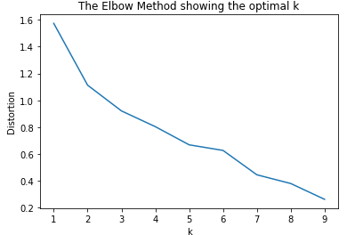
Clustering
K-Means Algorithm is used for clustering.
The Elbow method is used to find optimal value of K- i.e. the number of clusters.
K value of 5 is found to be optimal.

Slide 9
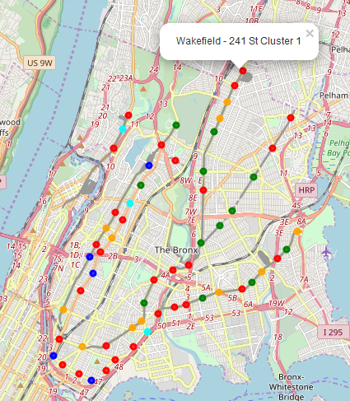
Clusters
Colour | Cluster
Red | 0
Blue | 1
Cyan | 2
Green | 3
Orange | 4

Slide 10
Analysis of Results
The best cluster is Cluster 4. They have very low or nill concentration of fast food joint and food trucks. This has almost no competitors for our client. This is the best set of stations to put up food trucks.
The second best cluster is Cluster 1. It has very low to nil concentration of food trucks with low concentration of fast food joints.
The third best cluster is Cluster 0. It has very low to nil concentration of food trucks with medium concentration of fast food joints.
The second least preferred cluster is Cluster 3. It has high concentration of fast food joint with low to medium concentration of food trucks.
The least preferred cluster is Cluster 2. It has high concentration of food trucks and low concentration of fast food joints.

Slide 11
Analysis of Result
Colour | Cluster | Cluster Rank
Red | 0 | 3
Blue | 1 | 2
Cyan | 2 | 5
Green | 3 | 4
Orange | 4 | 1

Slide 12
Conclusion and Way Forward
The analysis of result gives a clear understand of which subway stations are preferable to NYC Foods for setting up food trucks.
The method the we have used can be further expanded to include other boroughs and clustering of stations can be done for each borough. This will come in handy when our client NYC Foods plan to expand to other boroughs.
Furthermore, among the set of stations in the preferred cluster we can further narrow down and choose the best ones among them if we have passenger traffic data station wise. Higher traffic would mean higher the number of prospective consumers for our client.

